Slide 1
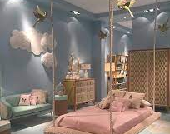
The new room of my dreams
The walls there are a little pink and white. There is a pink bed and a wardrobe and three shelves. There is a large carpet. There is a large mirror and a dressing table
lots of decor and flowers. I love my new room

